Slide 1
Image generation with generative adversarial networks
Dora Doljanin, Filip Pavičić

Slide 2
Goals
Familiarize with GANs
Test different architectures
“LSUN bedroom scene 20% sample” dataset
Achieve convergence
Calculate FID value
Compare results

Slide 3
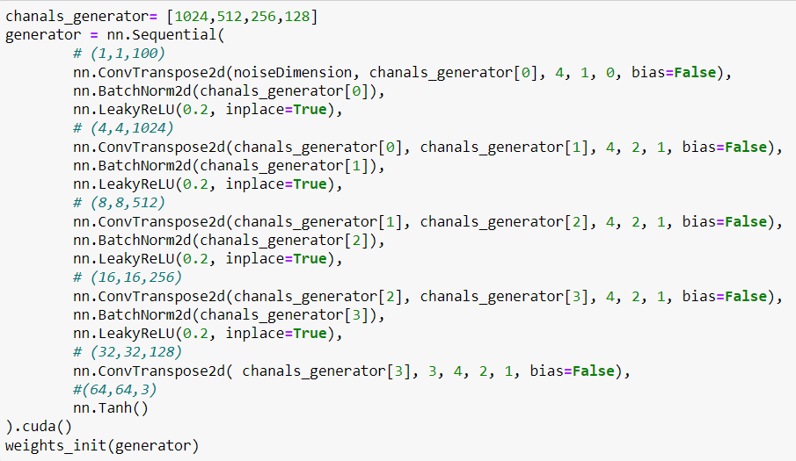
DCGAN - generator

Slide 4
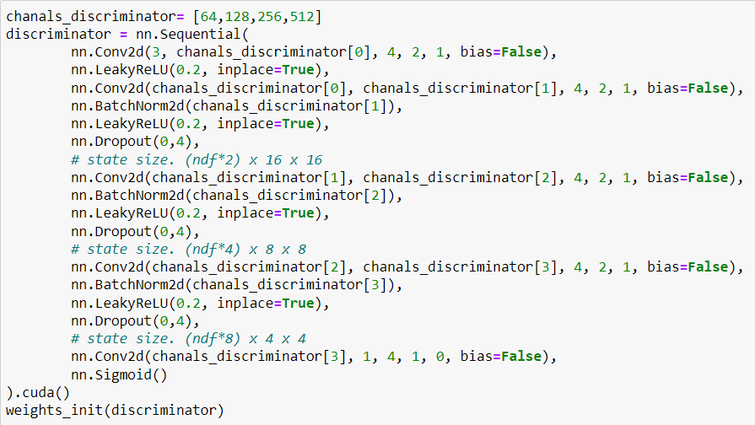
DCGAN - discriminator

Slide 5
Details
Optimizer: Adam
Loss: Cross Entropy loss function
Hyperparameters:
Learning rate = 0.0002
batch_size = 128
noiseDimension = 100
FID: 625.7 (after 5 epochs)

Slide 6
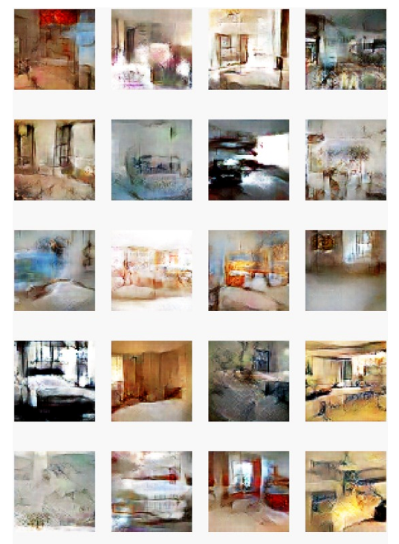
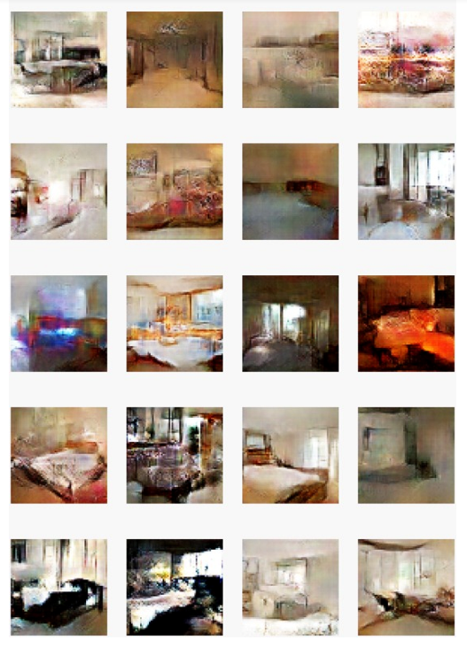

Slide 7
WGAN
Generator – same
Discriminator – removed sigmoid layer
Optimizer: RMSprop
Hyperparameters: lr1 = 0.00005
weight_clip = 0.01
n_critic = 5
batch_size = 64
noiseDimension = 100
Loss: lossD = -(torch.mean(output_real) - torch.mean(output_fake))
lossG = -torch.mean(output)
Training: clipping of the weights (Lipschitz constraint)
Results: low quality

Slide 8
WGAN-GP
WGAN with gradient penalty
interpolating between real and generated images
Generator – same
Discriminator - InstanceNorm2d instead of BatchNorm2d layer
Optimizer: Adam
Loss: lossD = -(torch.mean(output_real) - torch.mean(output_fake)) + lambda_gp * gp
lossG = - torch.mean(output)
Hyperparameters:
Dropout rate = 0.0001
• n_critic2 = 5
• lambda_gp = 10
• batch_size = 64
• noiseDimension = 100
FID: 943.18 (after 5 epochs)

Slide 9
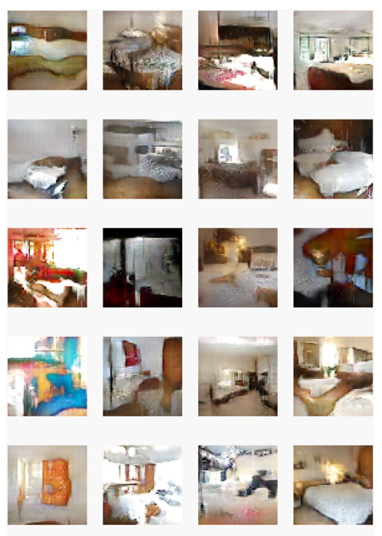
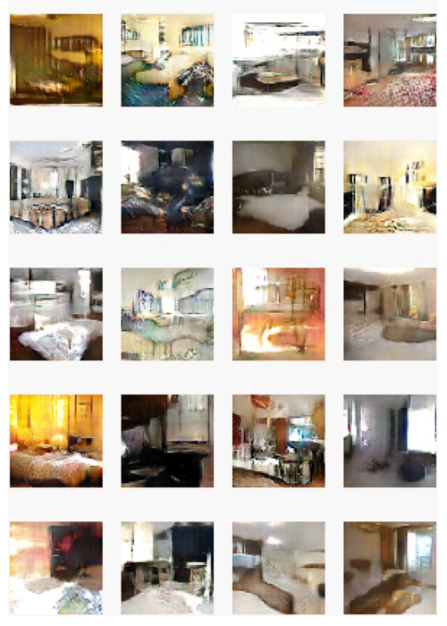

Slide 10
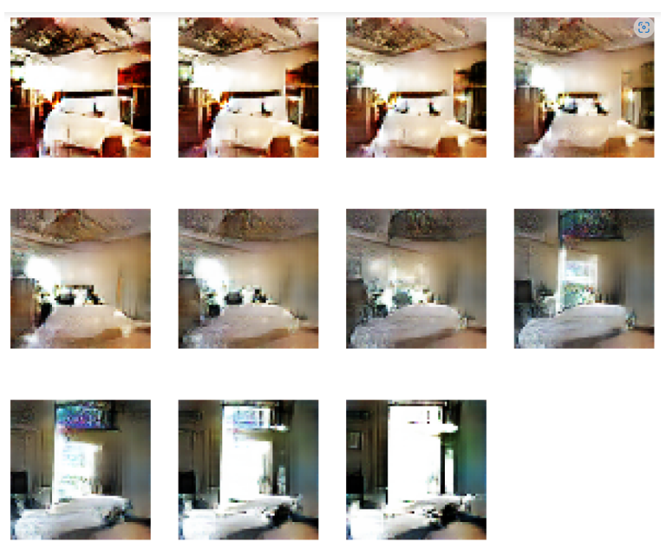
Image interpolation

Slide 11
Explanation
256 to the power of 12,288 possible combinations (parent’s space)
vast majority -> not reasonable bedroom image
Tiny subset - highly structured and continuous
Tiny subspace => space of initial vectors
Initial vectors -> generator -> parent’s space
interpolate between any 2 vectors from the set of initial vectors and obtain realistic bedroom images from the parent’s space

Slide 12
Conclusion
Convergence?
State-of-the-art
Time, resources

Slide 13
Thank you for your attention!

